Slide 1
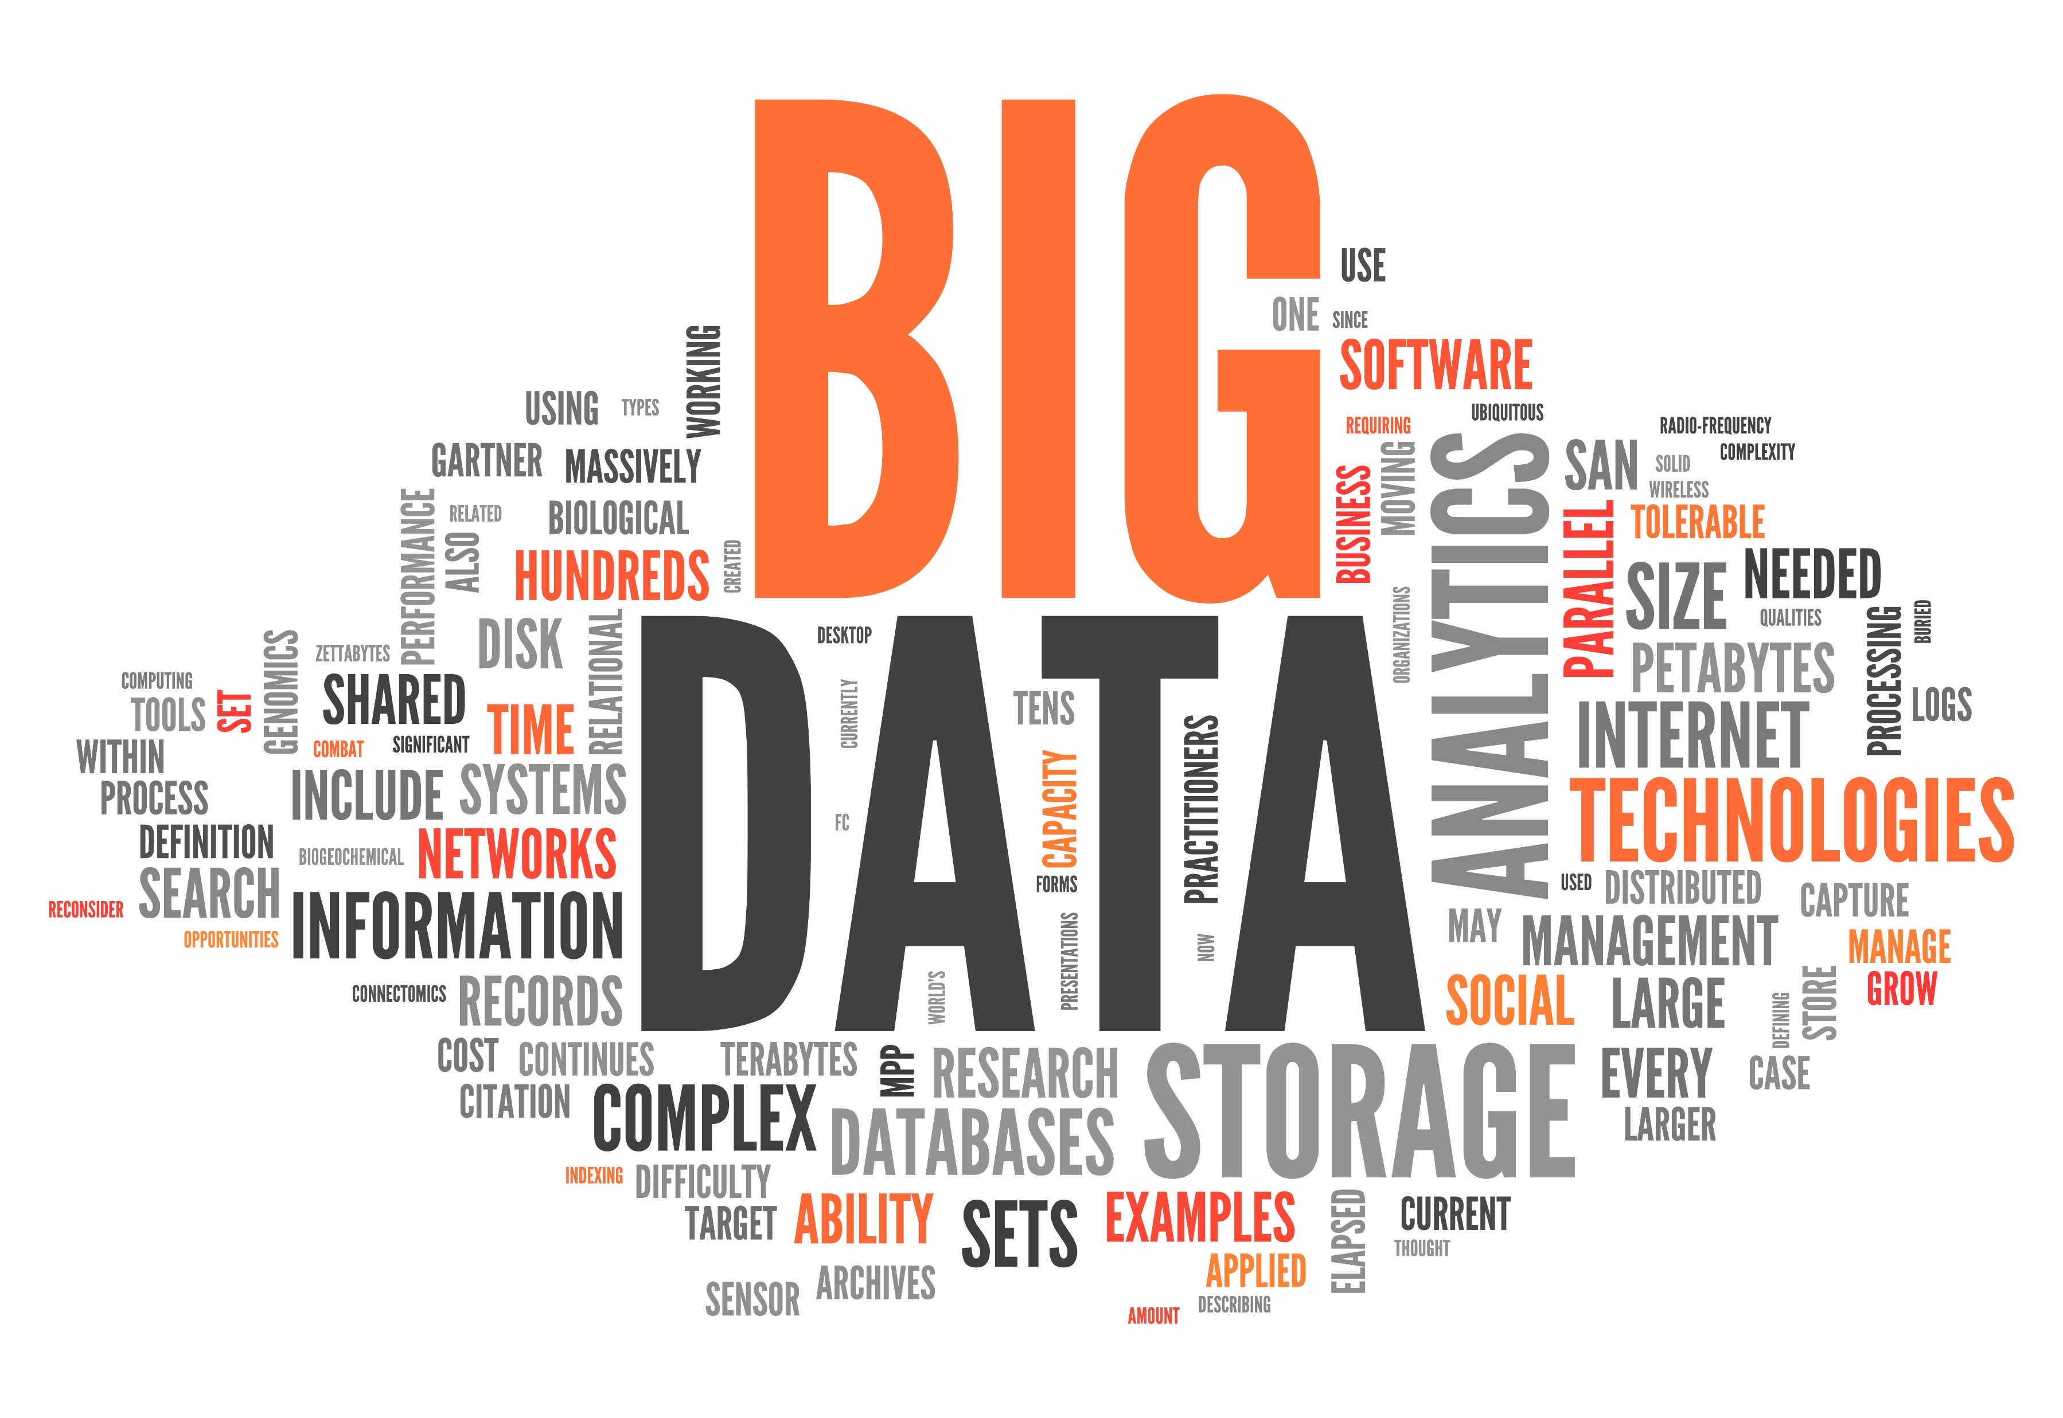
IS 669 - Big Data and Information
Systems
Group Project - Phase 2
This Photo by Unknown Author is licensed under CC BY-SA-NC

Slide 2
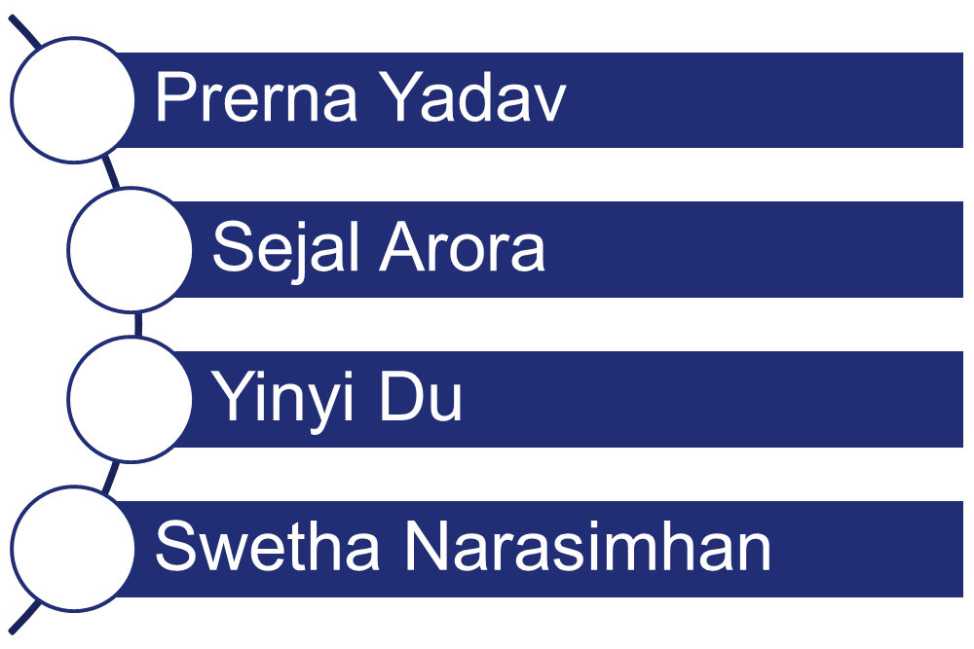
Team Members

Slide 3
Objective
Train, validate and test the analytics model with different segments of the combined sample data.
Agree on the best team model to predict the delay of twelve flight records provided by the professor.
We Combined the Year 2007, 1995, 1998, 2008.

Slide 4
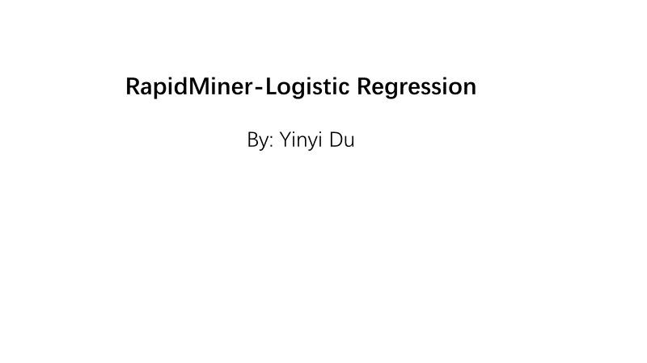

Slide 5
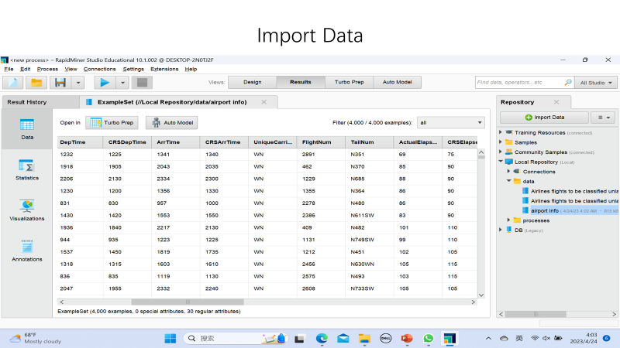

Slide 6
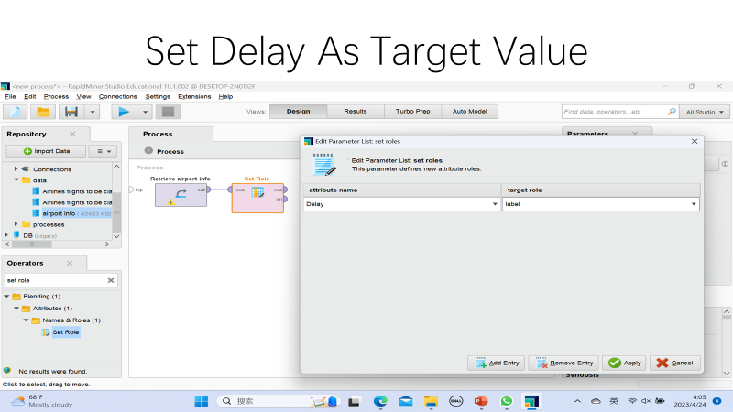

Slide 7
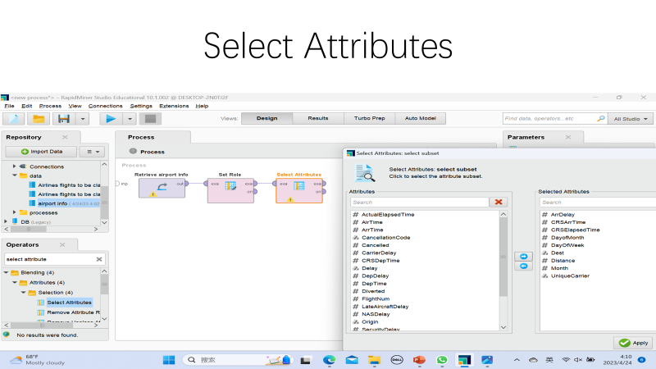

Slide 8
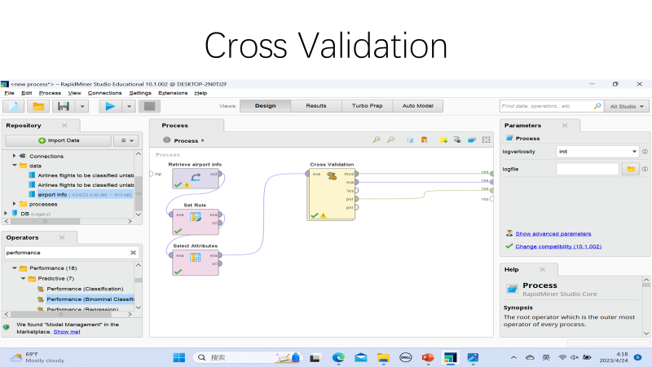

Slide 9
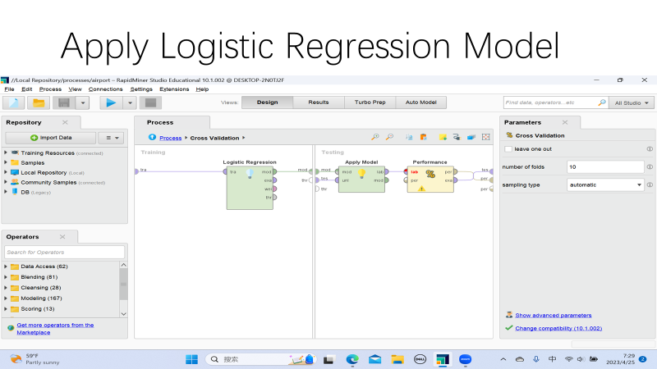

Slide 10
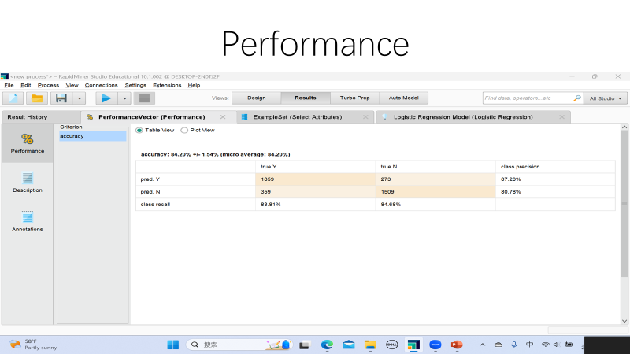

Slide 11
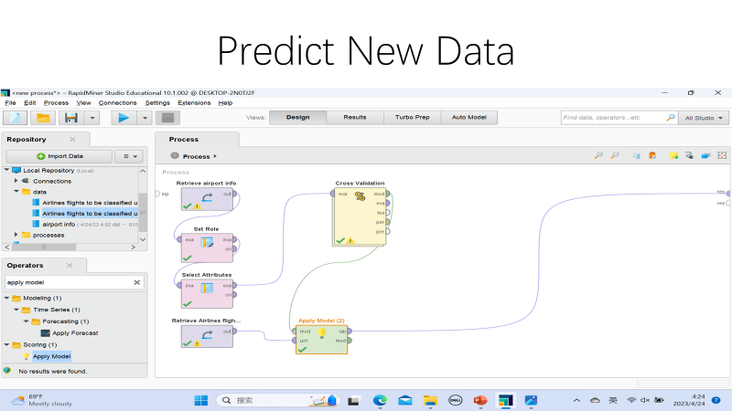

Slide 12
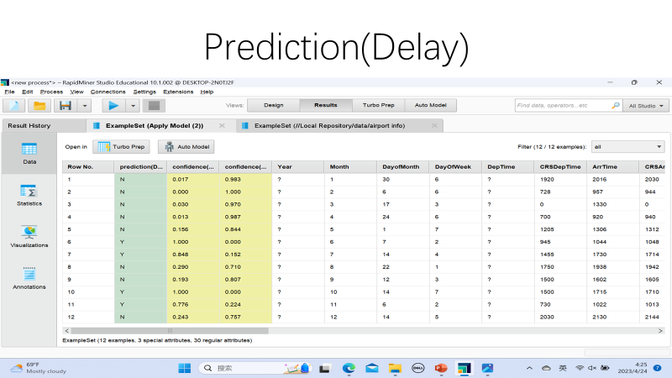

Slide 13
Random Forest Classifier
- Swetha Narasimhan

Slide 14
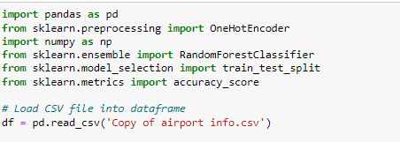
Creating Pandas Dataframe
Swetha Narasimhan

Slide 15
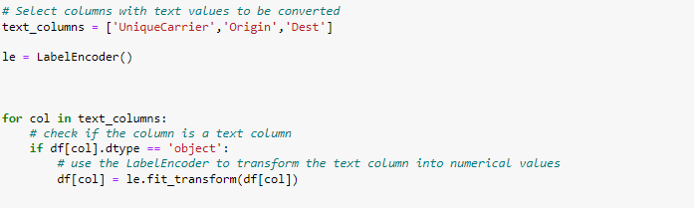
Encoding Text values to Numerical Values for Classifier Model using Label Encoder
Swetha Narasimhan

Slide 16
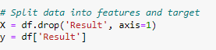
Setting the features and target
Swetha Narasimhan

Slide 17
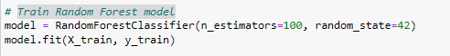
Splitting the data to training and test set
Train Random Forest model
Swetha Narasimhan

Slide 18
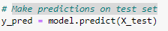
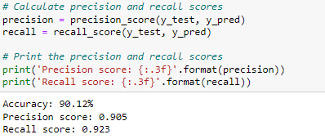
Make predictions on test set
Calculate Performance Metrics
Swetha Narasimhan

Slide 19
Linear Regression
- Prerna Yadav

Slide 20
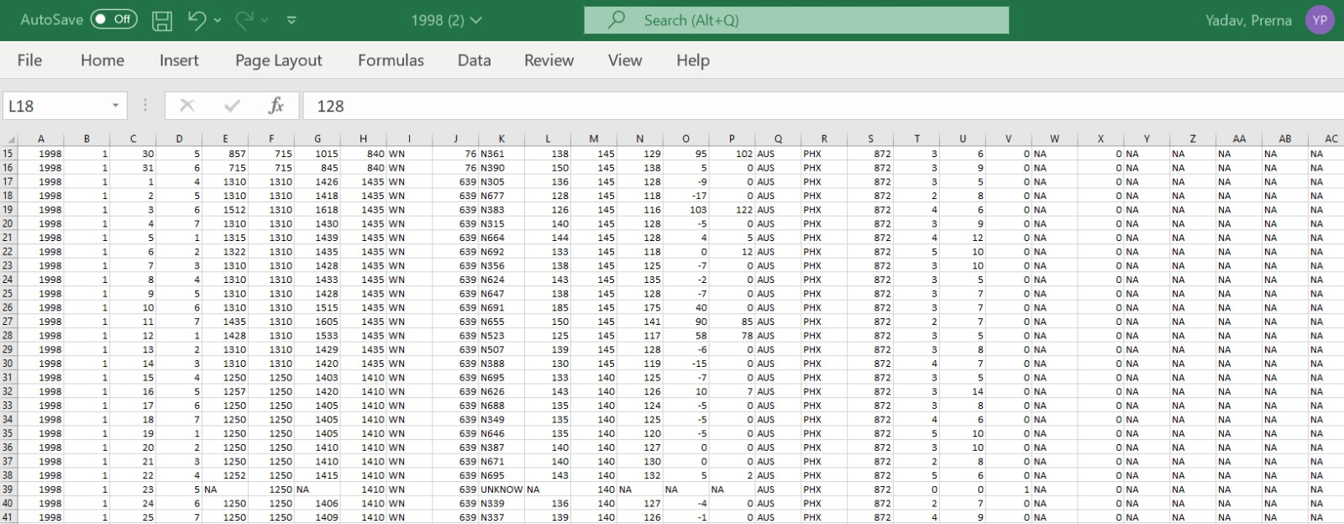
Excel Data Set -1998

Slide 21
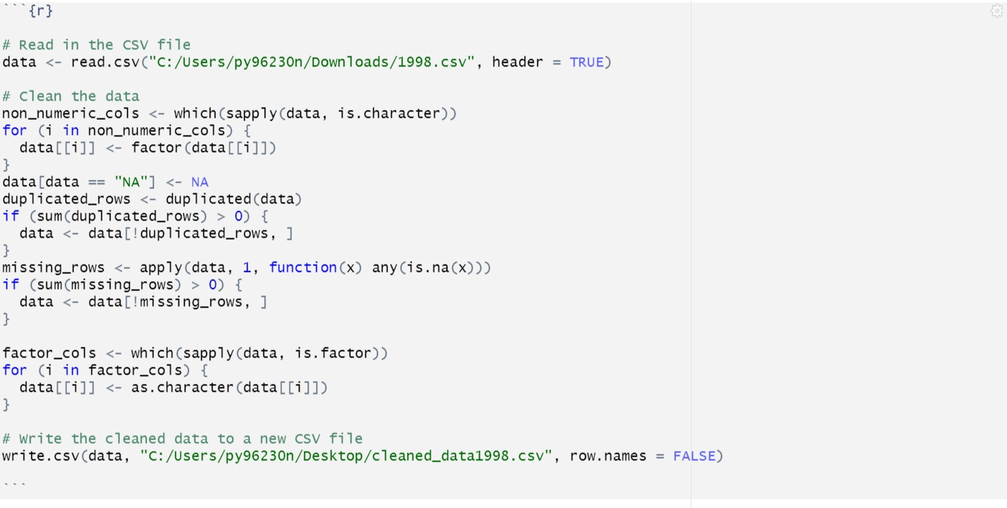
Cleaning Data

Slide 22
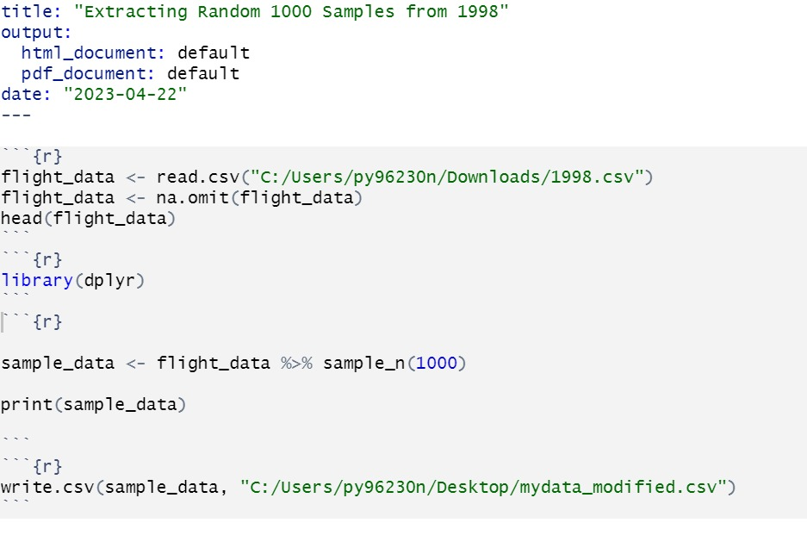
Extracting Random Samples from Cleaned Data

Slide 23
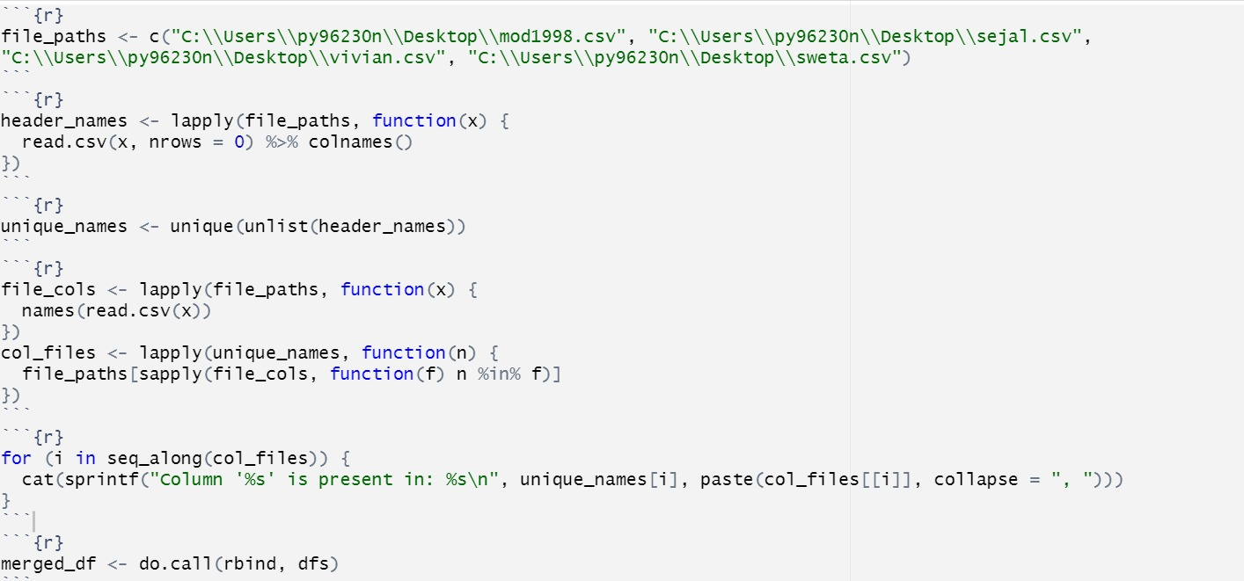
Combine All Years Data In single Csv file.

Slide 24
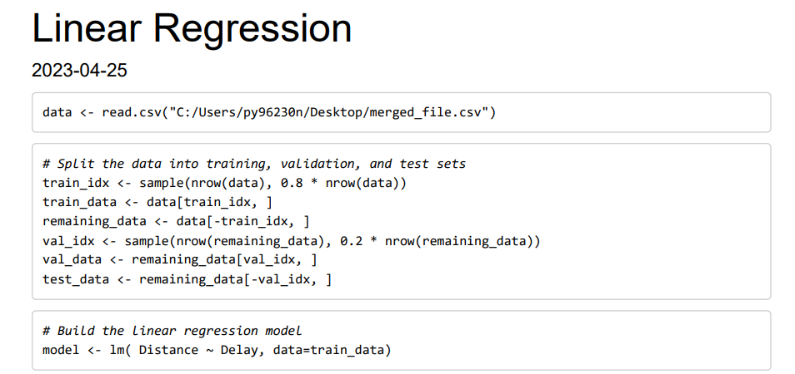
Splitting the data 80 % to 20%

Slide 25
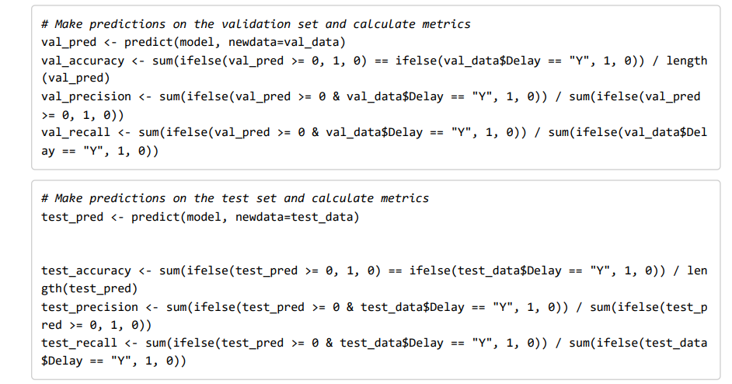
Predicting and Calculating Metrics

Slide 26
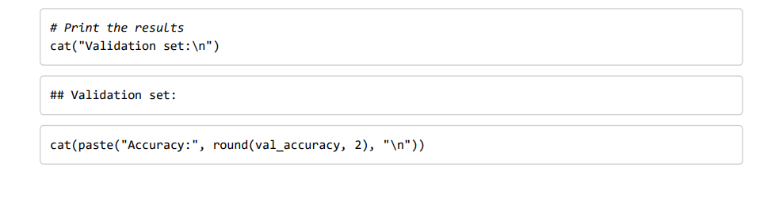
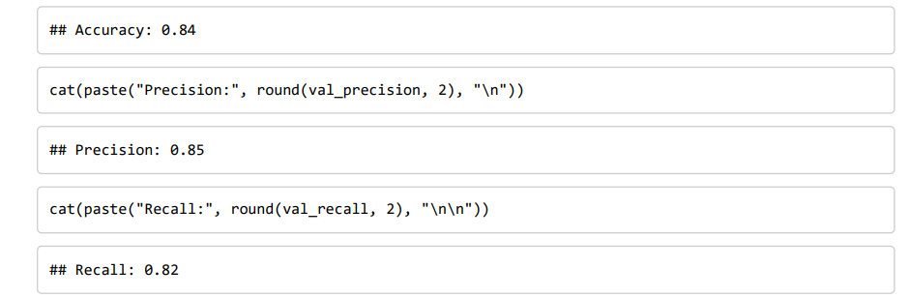
Results

Slide 27
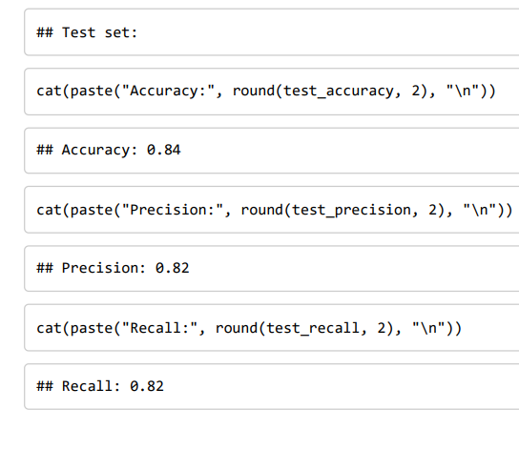
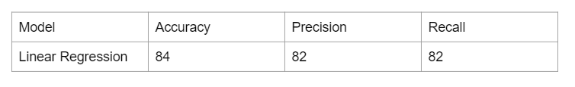
Results

Slide 28
Name : Sejal Arora
Year: 2008
Model: Deep Learning

Slide 29
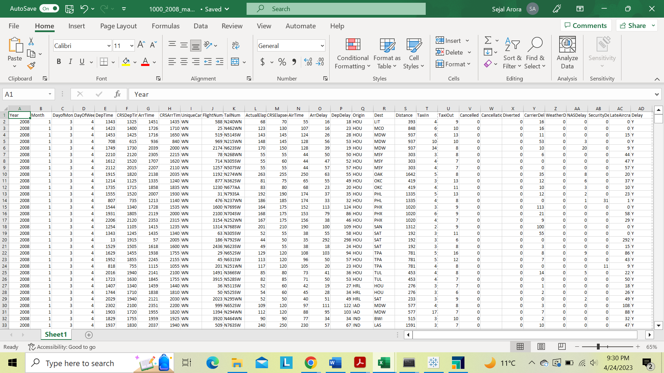
Step 1: Filter the data and Extract 1000 records from the Dataset
Step 2: Add the Delay column in the dataset and put a “N” in the Delay column if the record has a value of zero or less in the ArrDelay and DepDelay columns, otherwise add a “Y”.
Sejal Arora

Slide 30
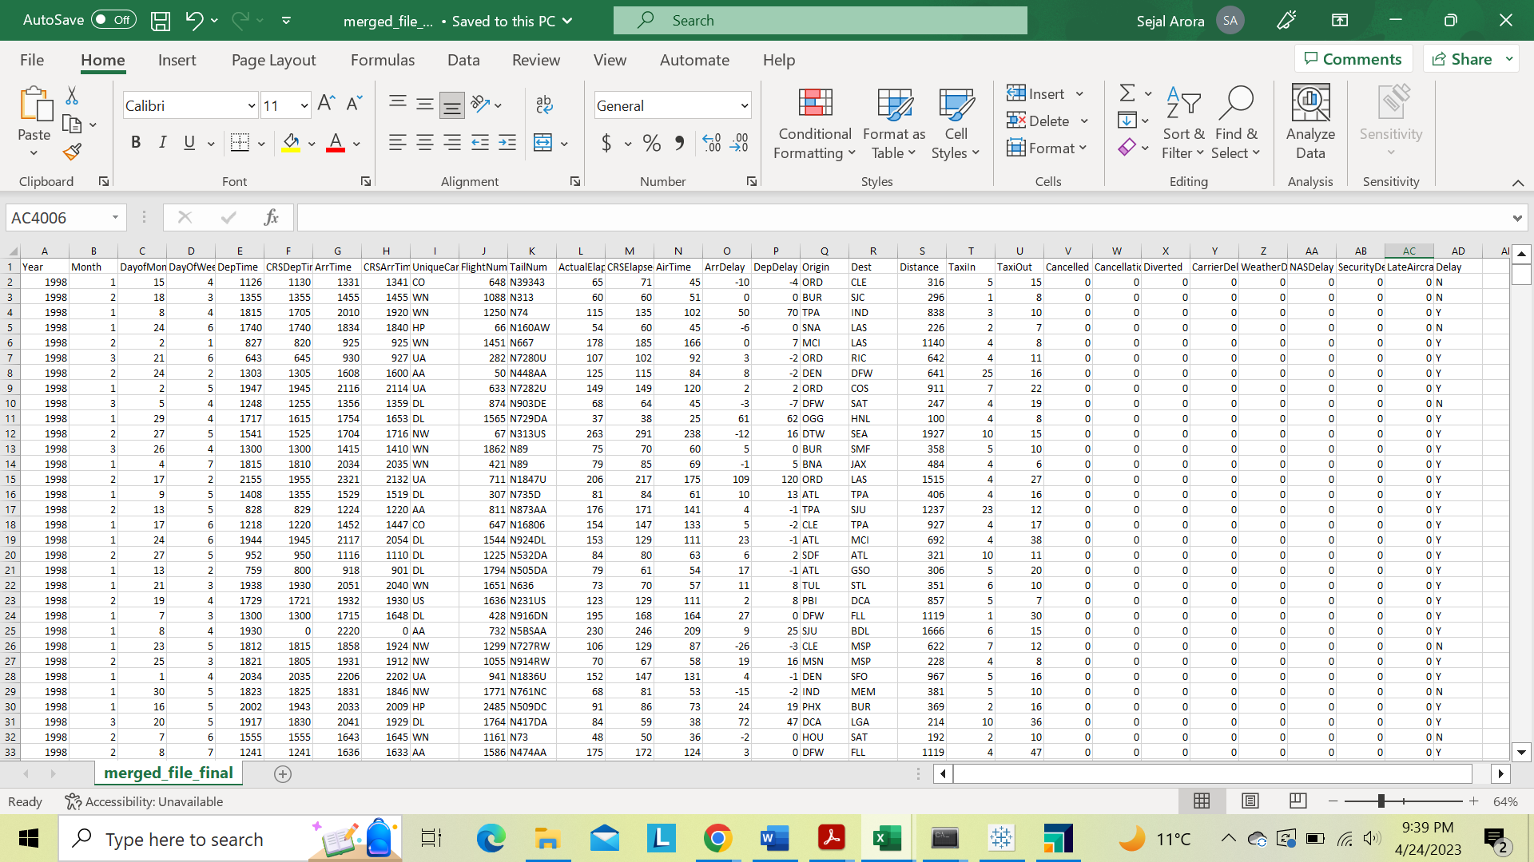
Step 2: Combine all the year’s data files into one file
Sejal Arora

Slide 31
Model : Deep Learning
Deep learning is a subset of machine learning (ML) that involves using artificial neural networks with many layers to solve complex problems.
It is called "deep" because it involves training artificial neural networks with multiple layers, which allows them to learn from large amounts of data and make accurate predictions or decisions.
Deep learning algorithms are typically trained on large datasets.
Sejal Arora

Slide 32
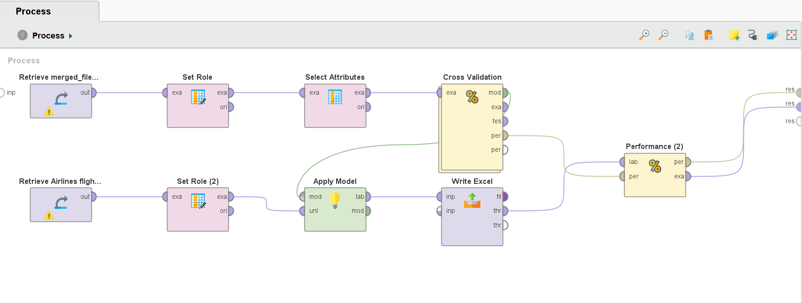
Step 3: Applying model using RapidMiner
Set Delay as label
Sejal Arora

Slide 33
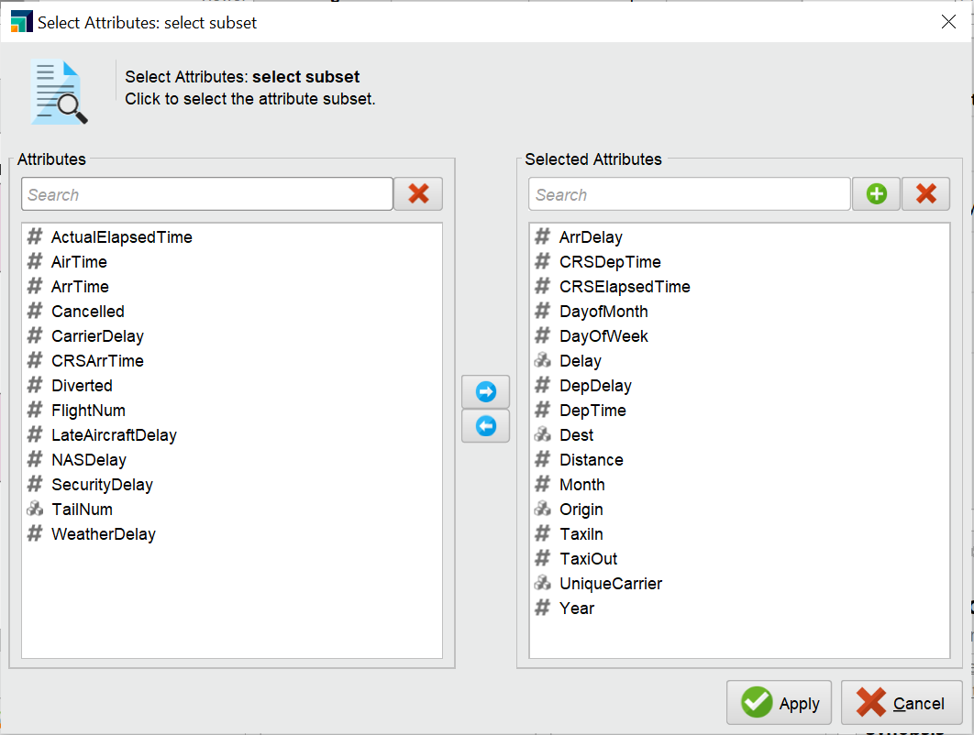
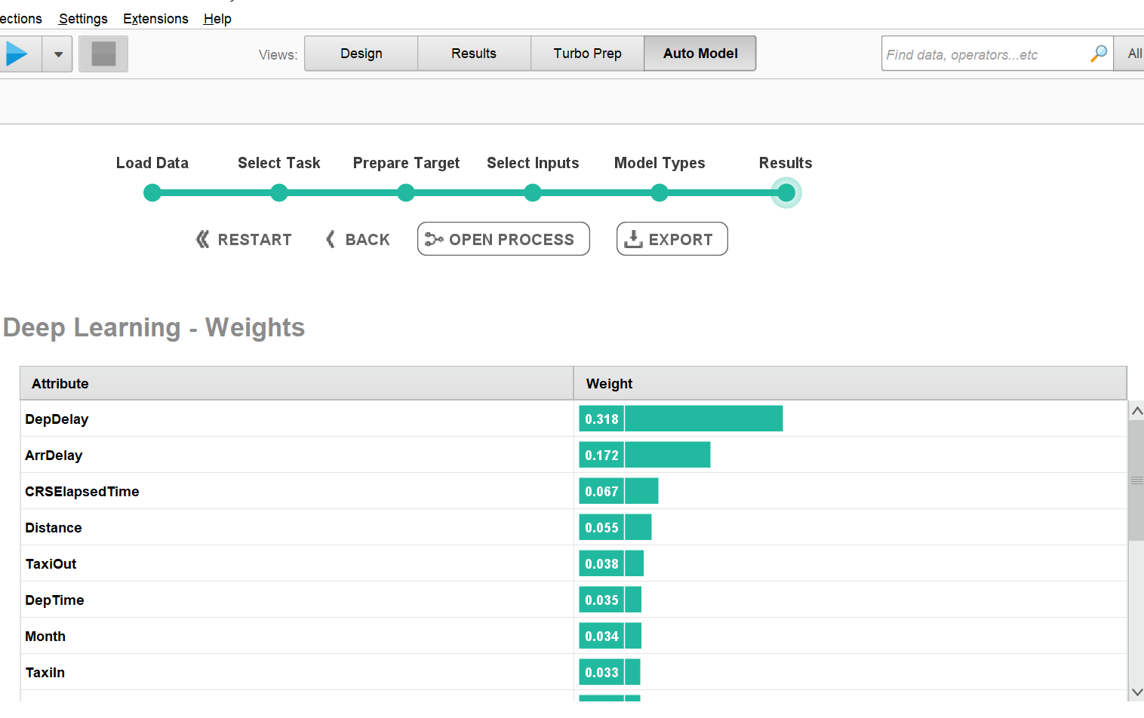
Selected Attributes
Sejal Arora

Slide 34
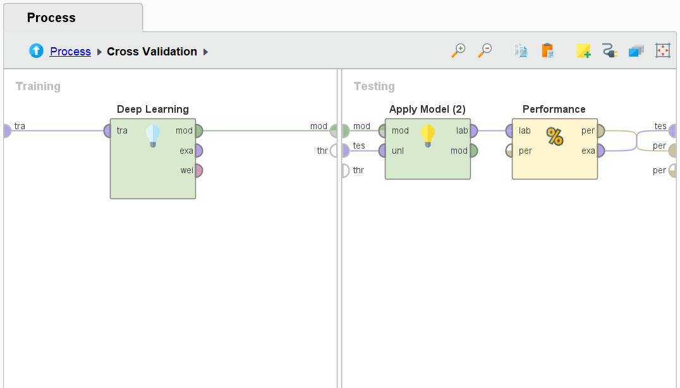
Cross Validation
Sejal Arora

Slide 35
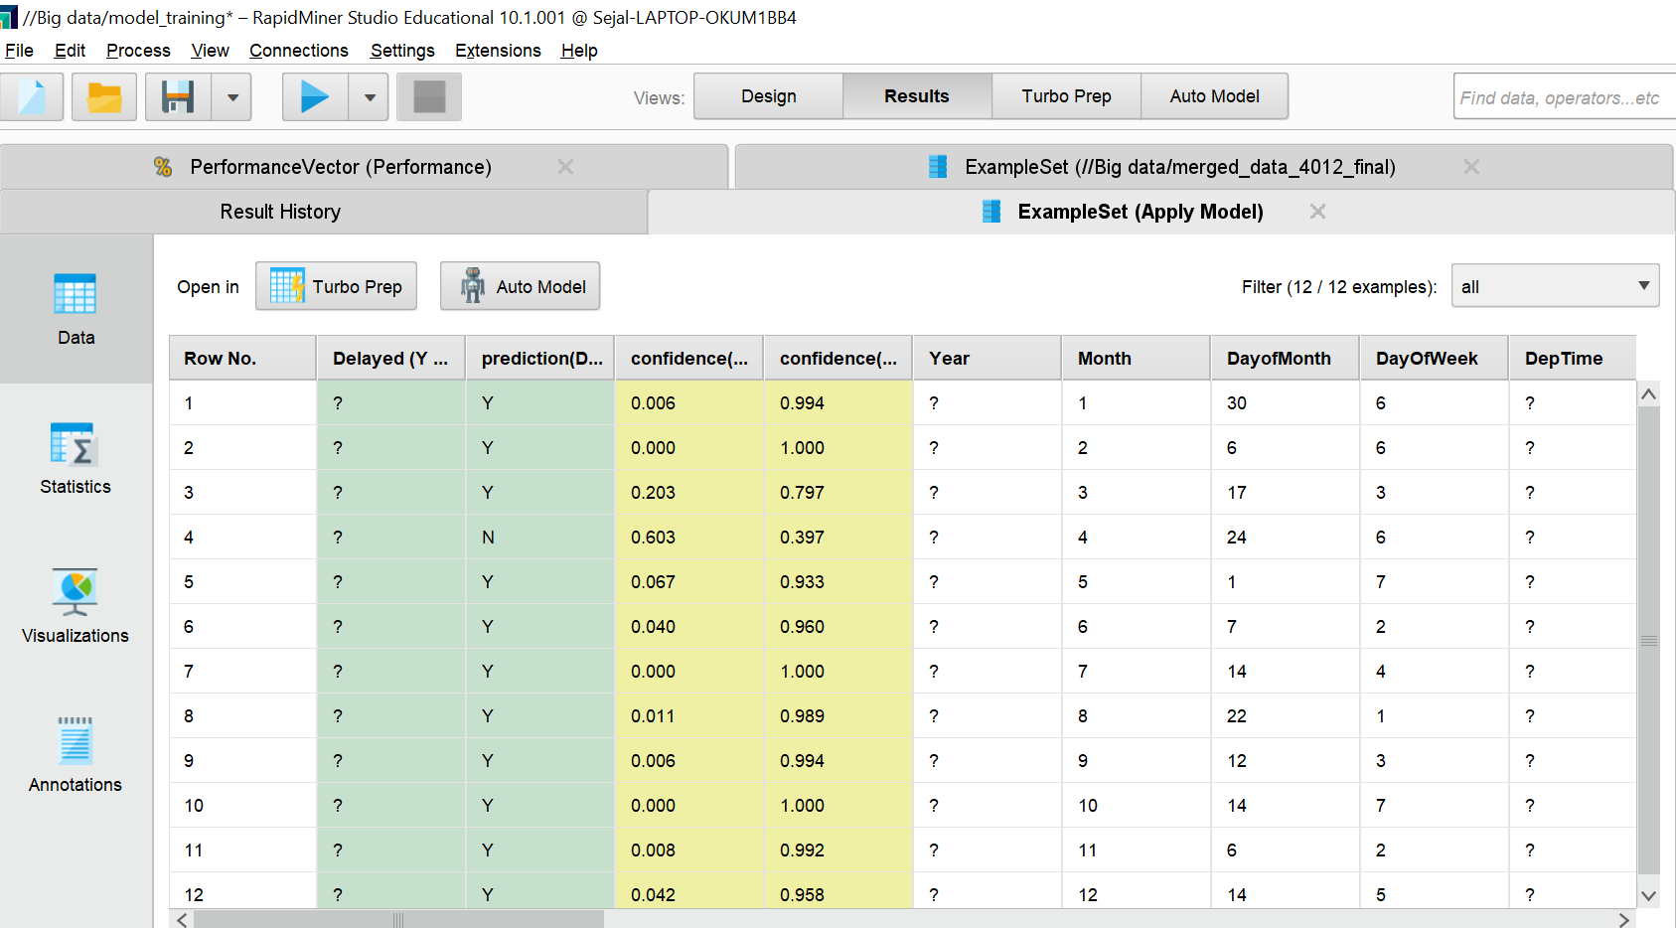
Result
Sejal Arora

Slide 36
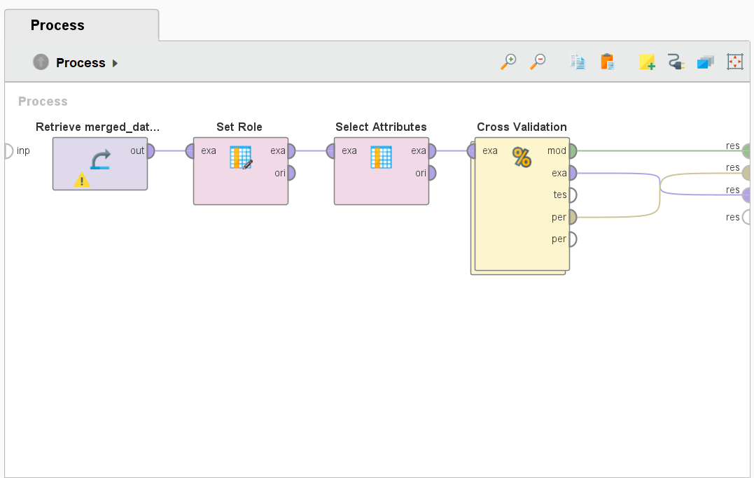
Step 4: New Process for the Merged Dataset
Sejal Arora

Slide 37
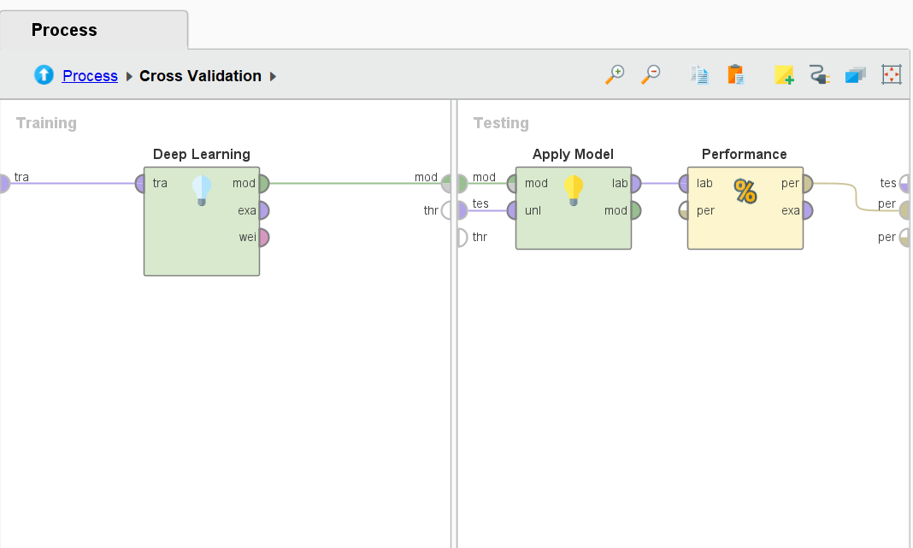
Cross Validation
Sejal Arora

Slide 38
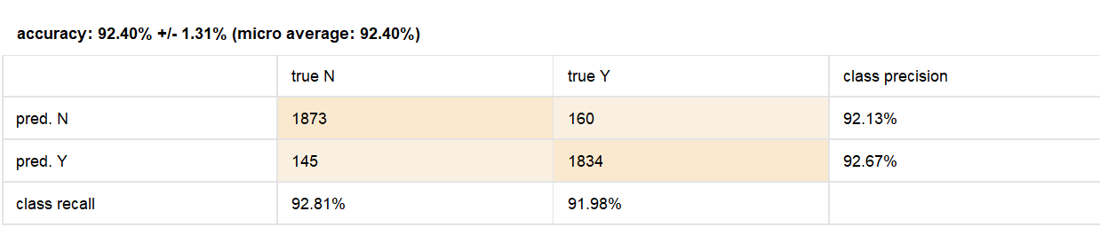
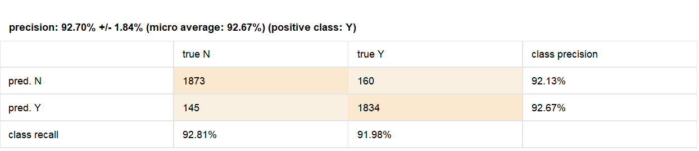
Results
Accuracy: 92.4%, Precision: 92.7%, Recall: 91.98%
Sejal Arora

Slide 39
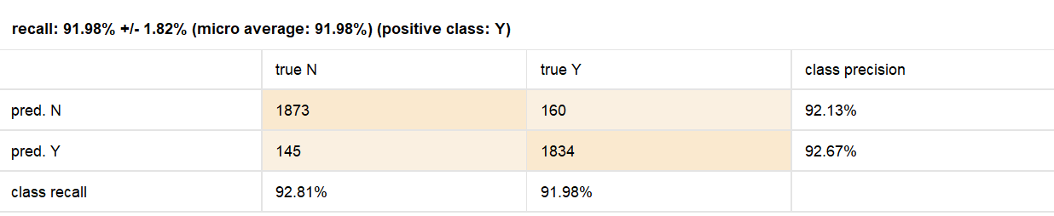
Results
Sejal Arora

Slide 40
Result Summary
The model made predictions on two classes, "N" and "Y". "True N" represents the actual number of instances where the class is "N", while "True Y" represents the actual number of instances where the class is "Y".
The precision of the "N" class is 92.13%, which means that out of all the instances predicted as "N" by the model, 92.13% of them were actually "N". Similarly, the precision of the "Y" class is 92.67%, which means that out of all the instances predicted as "Y" by the model, 92.67% of them were actually "Y".
The class recall represents the percentage of instances correctly identified by the model for each class. The recall for the "N" class is 92.81%, which means that out of all the instances that are actually "N", the model correctly identified 92.81% of them. Similarly, the recall for the "Y" class is 91.98%, which means that out of all the instances that are actually "Y", the model correctly identified 91.98% of them. Overall, these results indicate that the deep learning model has achieved a high level of accuracy and can effectively predict the two classes.
Sejal Arora

Slide 41
Conclusion
Model | Accuracy | Precision | Recall
Deep Learning | 92.4 | 92.7 | 91.98
Logistic Regression | 84.2 | 88.66 | 84.68
Random Forest | 90.1 | 90.5 | 92.3
Linear Regression | 84 | 82 | 82
Based on our testing, the model that performed better in terms of Accuracy, Precision and Recall was Deep Learning.

